Slide 1
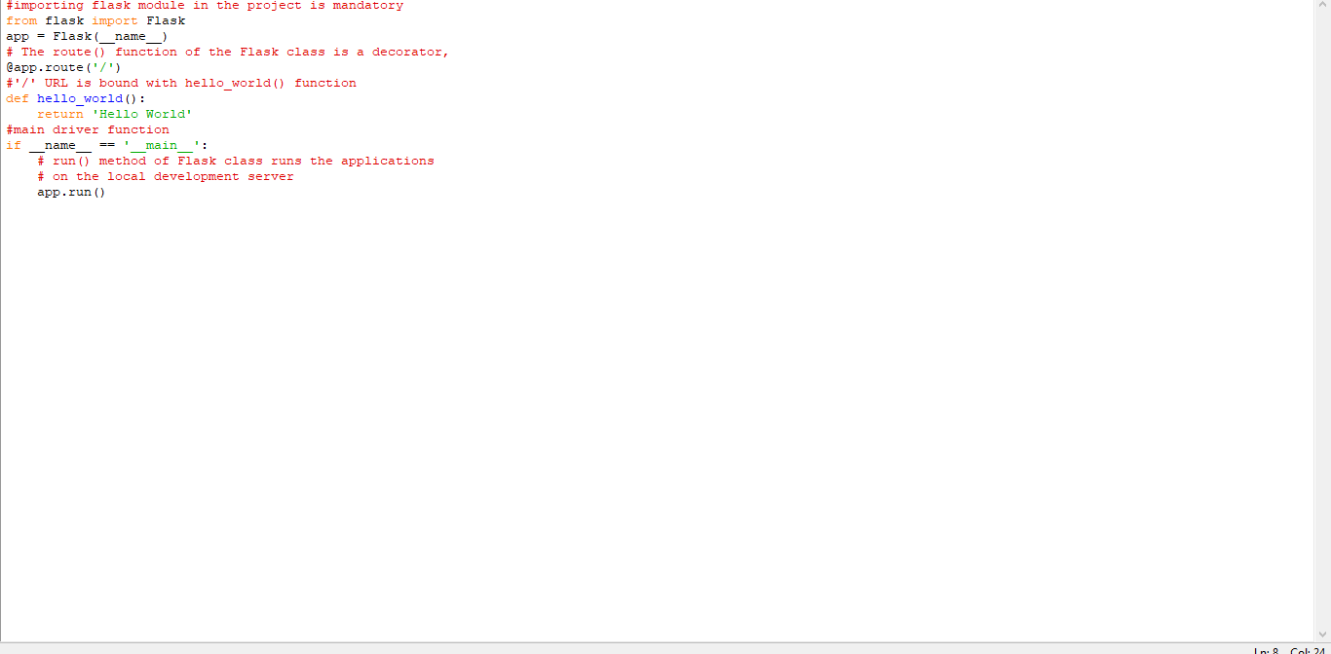
Environment Setup
FLASK PROJECT
Team ID : PNT2022TMID07573
Program:

Slide 2
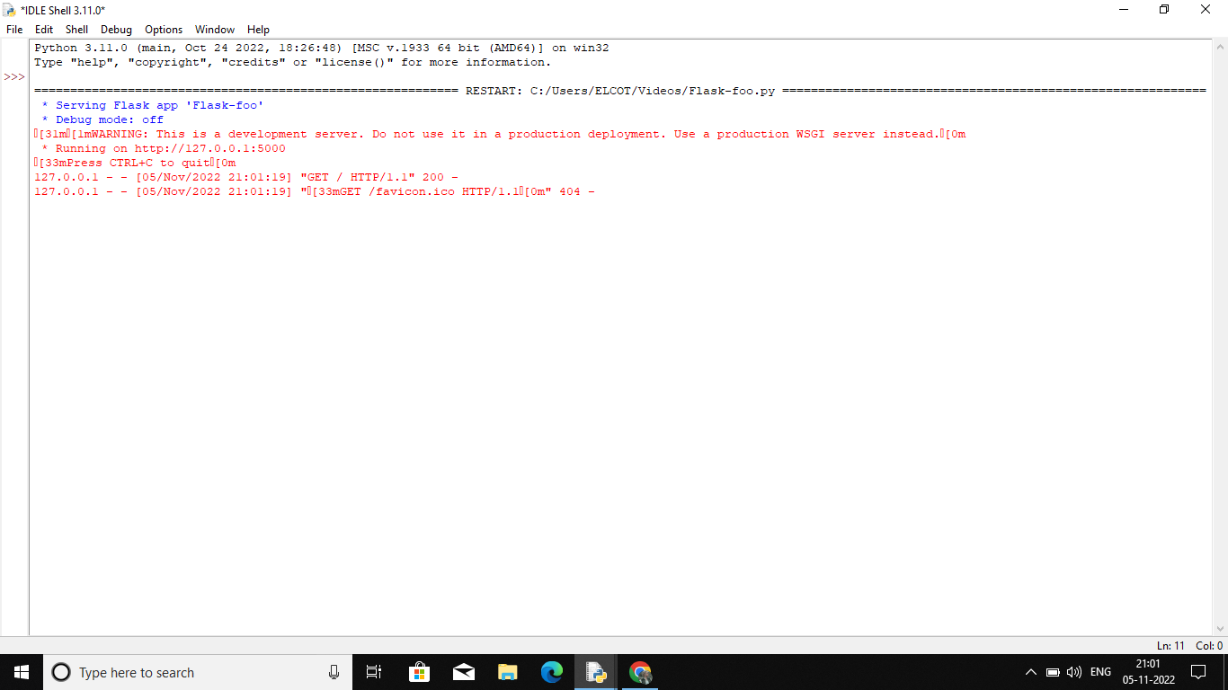
Terminal:

Slide 3
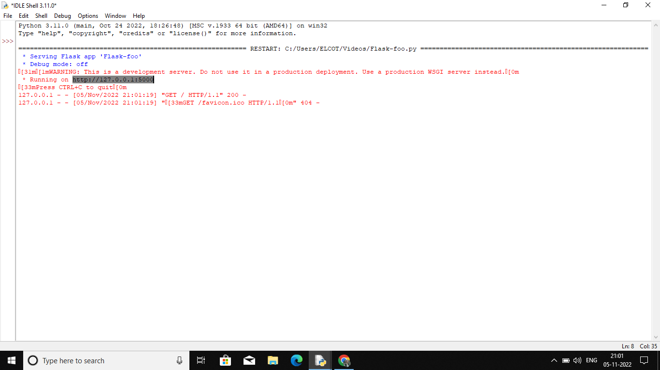

Slide 4
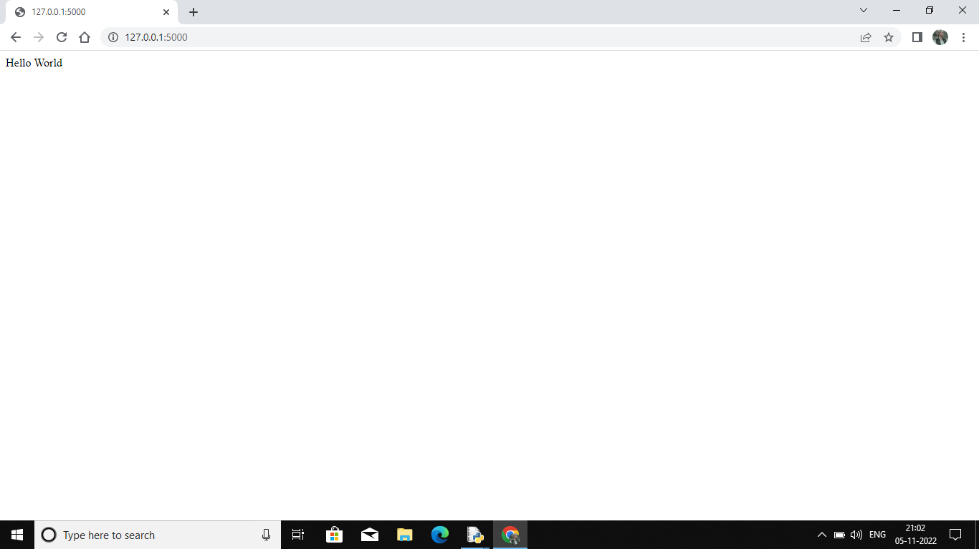
Output:

